Slide 1
A brief introduction
TypeScript

Slide 2
What is TypeScript?
An optionally typed (but strict!) superset of Javascript (A programming language that contains all the features of a given language and has been expanded or enhanced to include other features as well)
Compiles down to Javascript
Easy to learn (especially for those coming from C based languages like Java, C#, C++!)
Well supported - Webstorm, PHP Storm, Visual Studio, Eclipse, IntelliJ IDEA, Node.Js and more
Developed by Microsoft, open sourced under the Apache 2 license

Slide 3
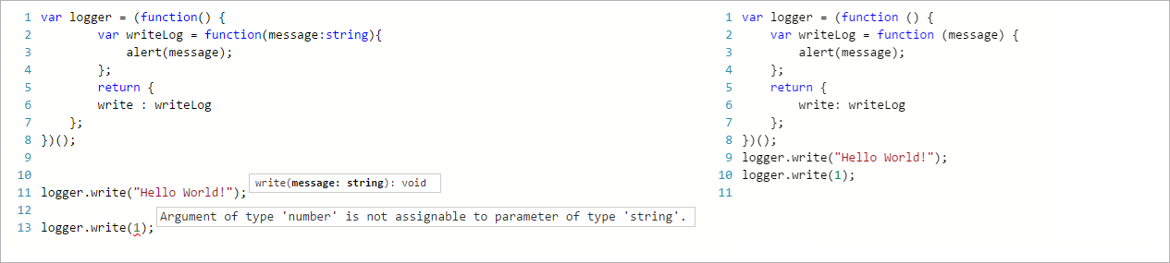
What is TypeScript?
Javascript is valid TypeScript!

Slide 4
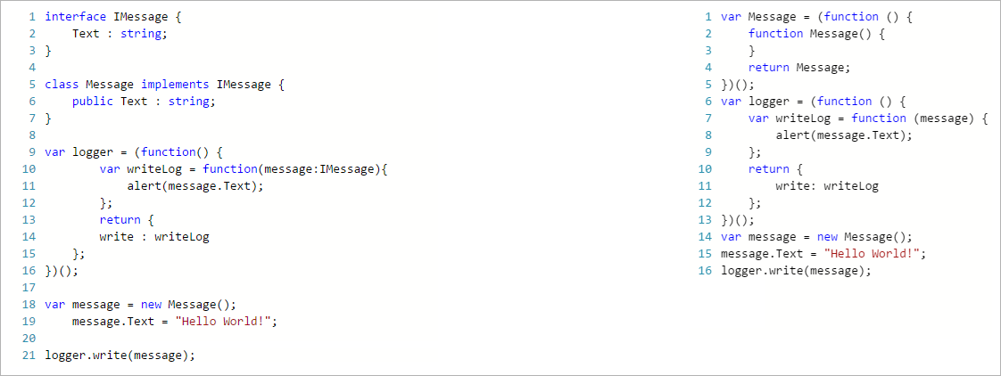
What is TypeScript?

Slide 5
What is TypeScript?
Features
Type inference
Classes
Interfaces
Enumerated types
Mixins
Generic
Modules
Lambda Expressions
Optional parameters and default parameters
Tuples
Declaration files (TypeDefinitions)

Slide 6
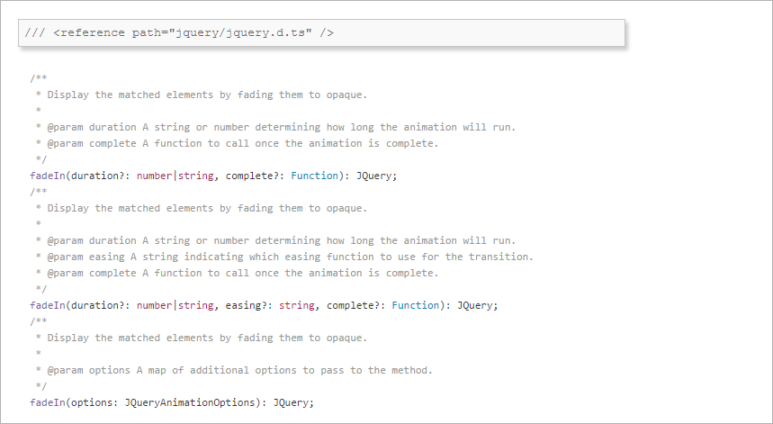
What is TypeScript?
Type Definitions Files
(Declaration file (with the extension .d.ts) that functions as an interface)

Slide 7
What problem does it solve?
Large, difficult to maintain Javascript - intellisense - type safety - compile safety - additional ECMAScript 6 features

Slide 8
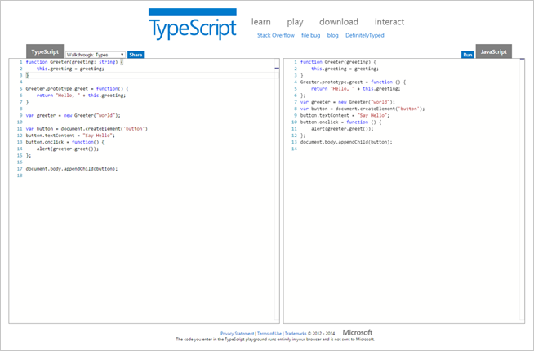
Want to learn more?
http://www.typescriptlang.org/Playground
http://definitelytyped.org

